Slide 1
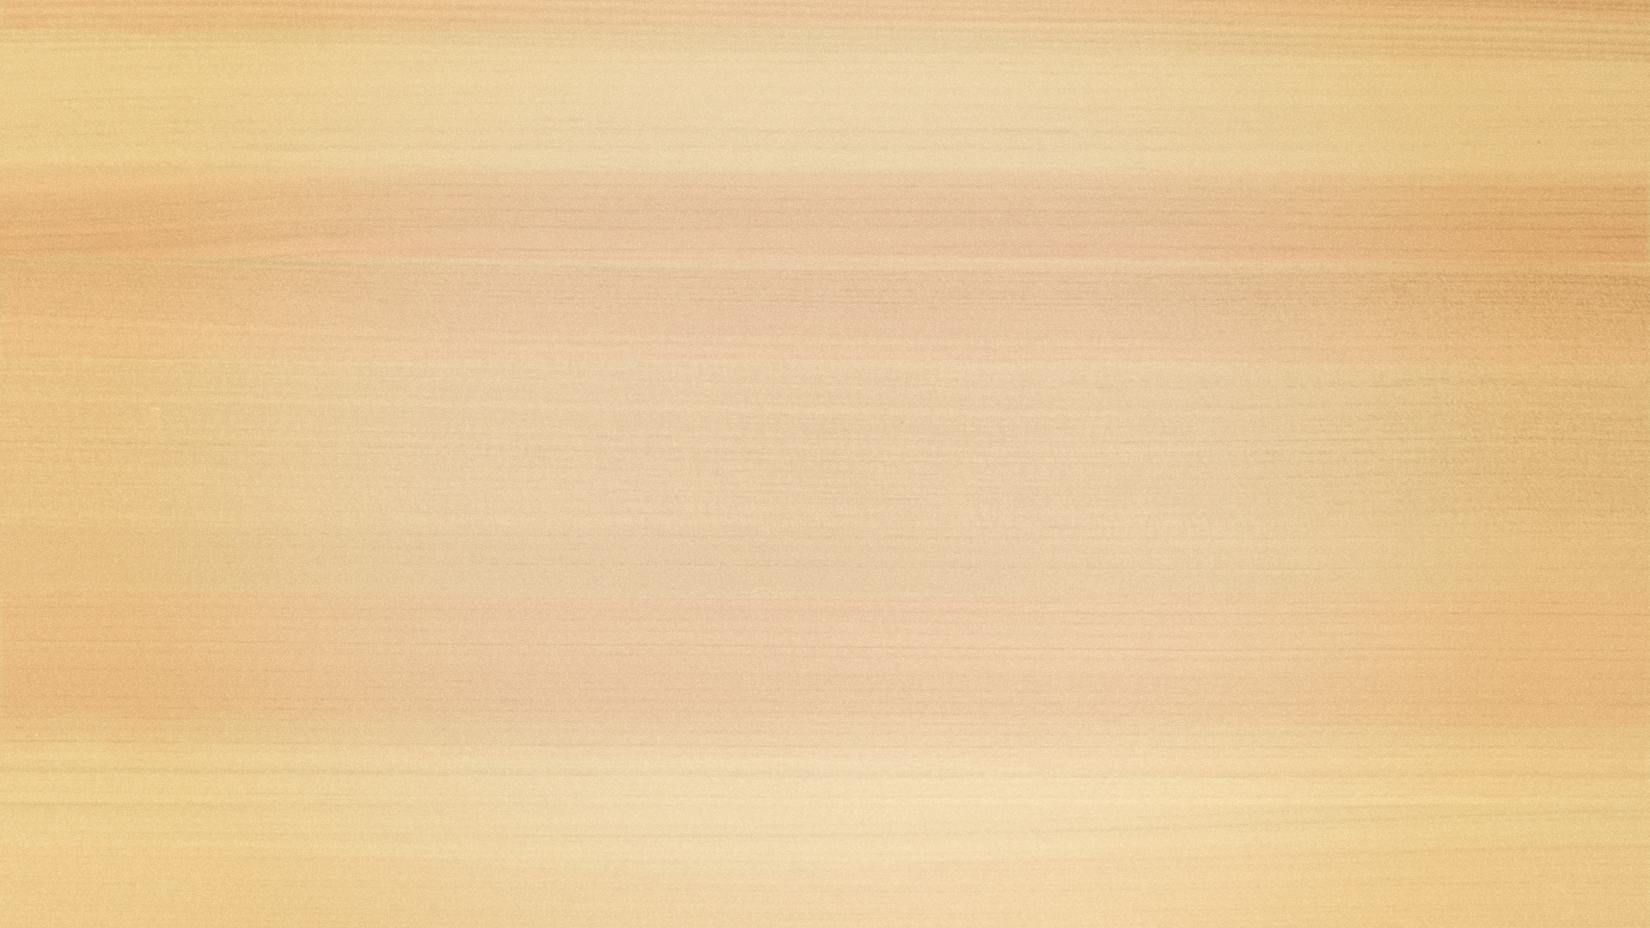
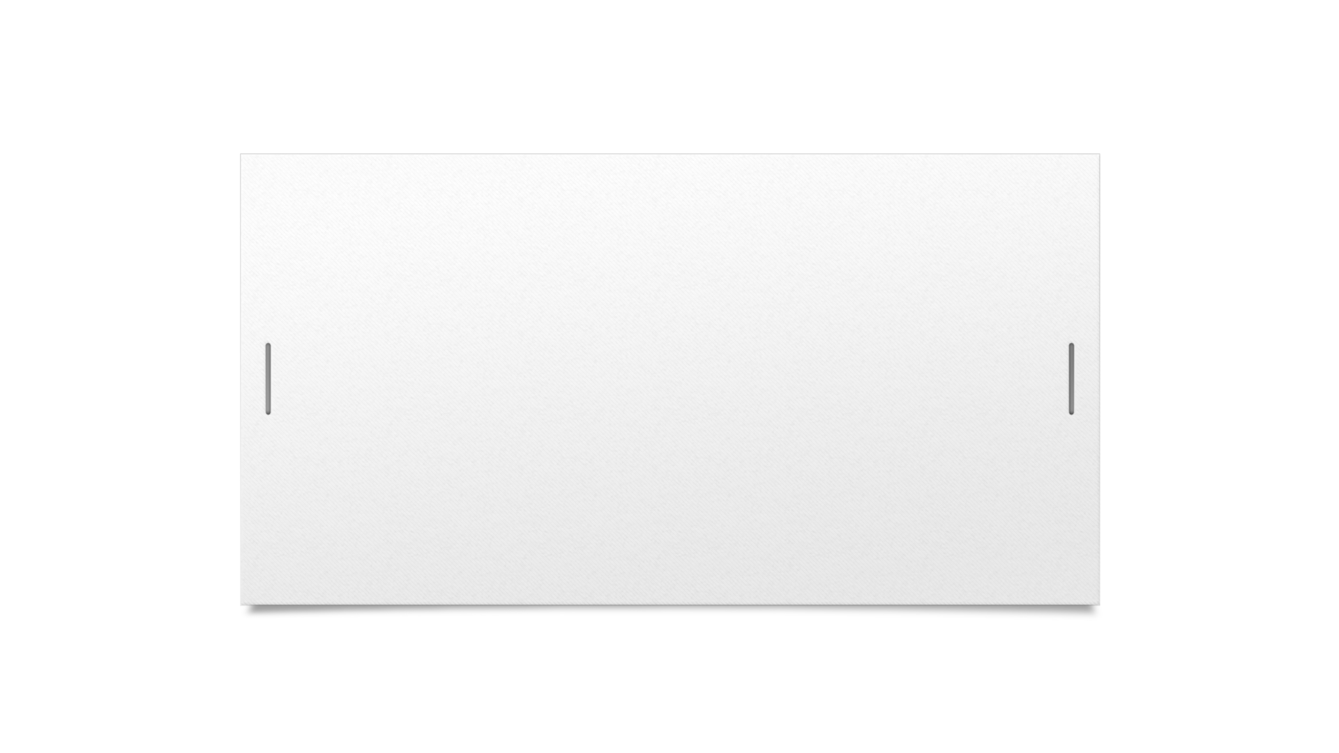
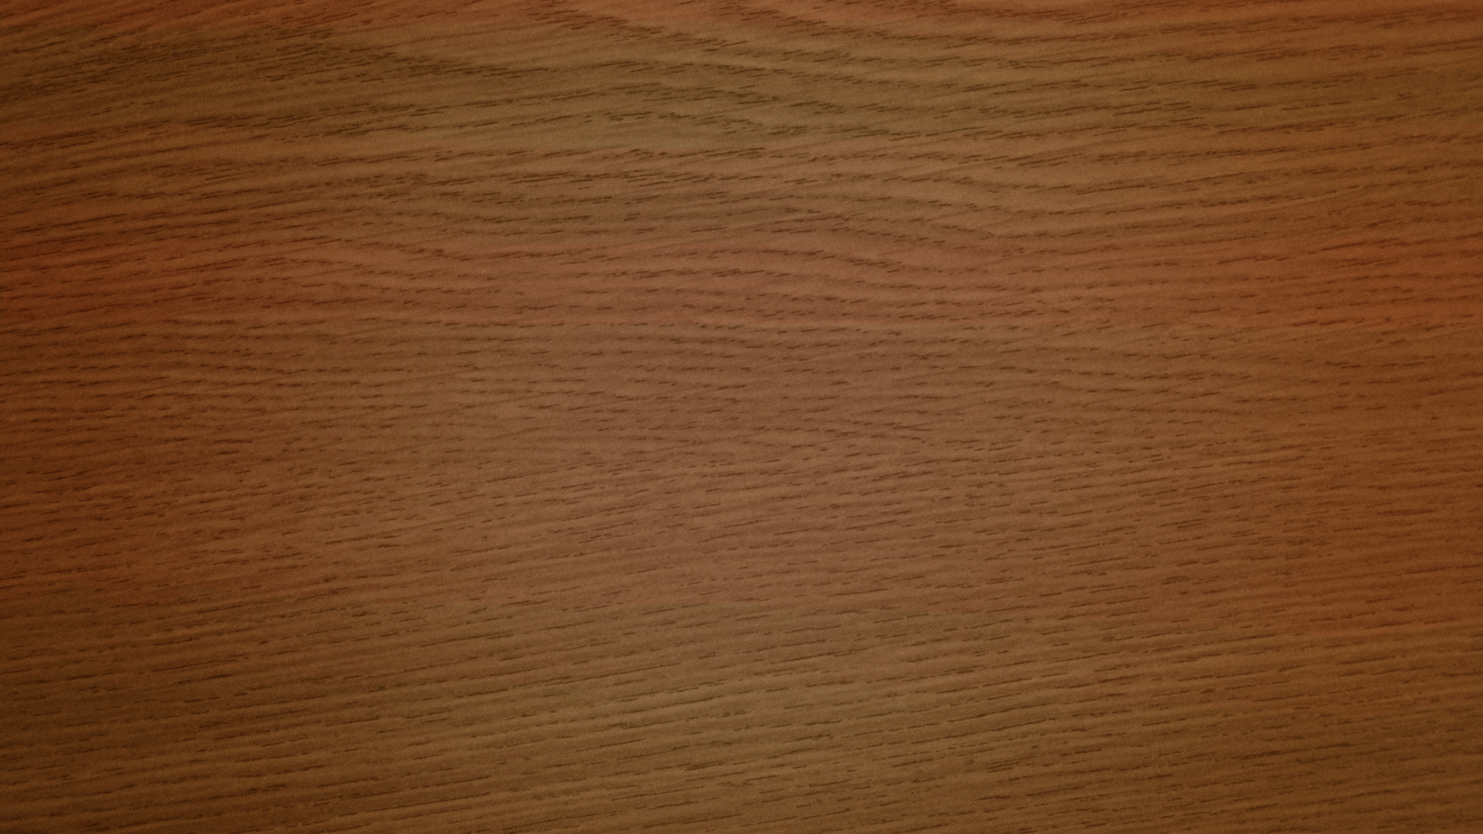
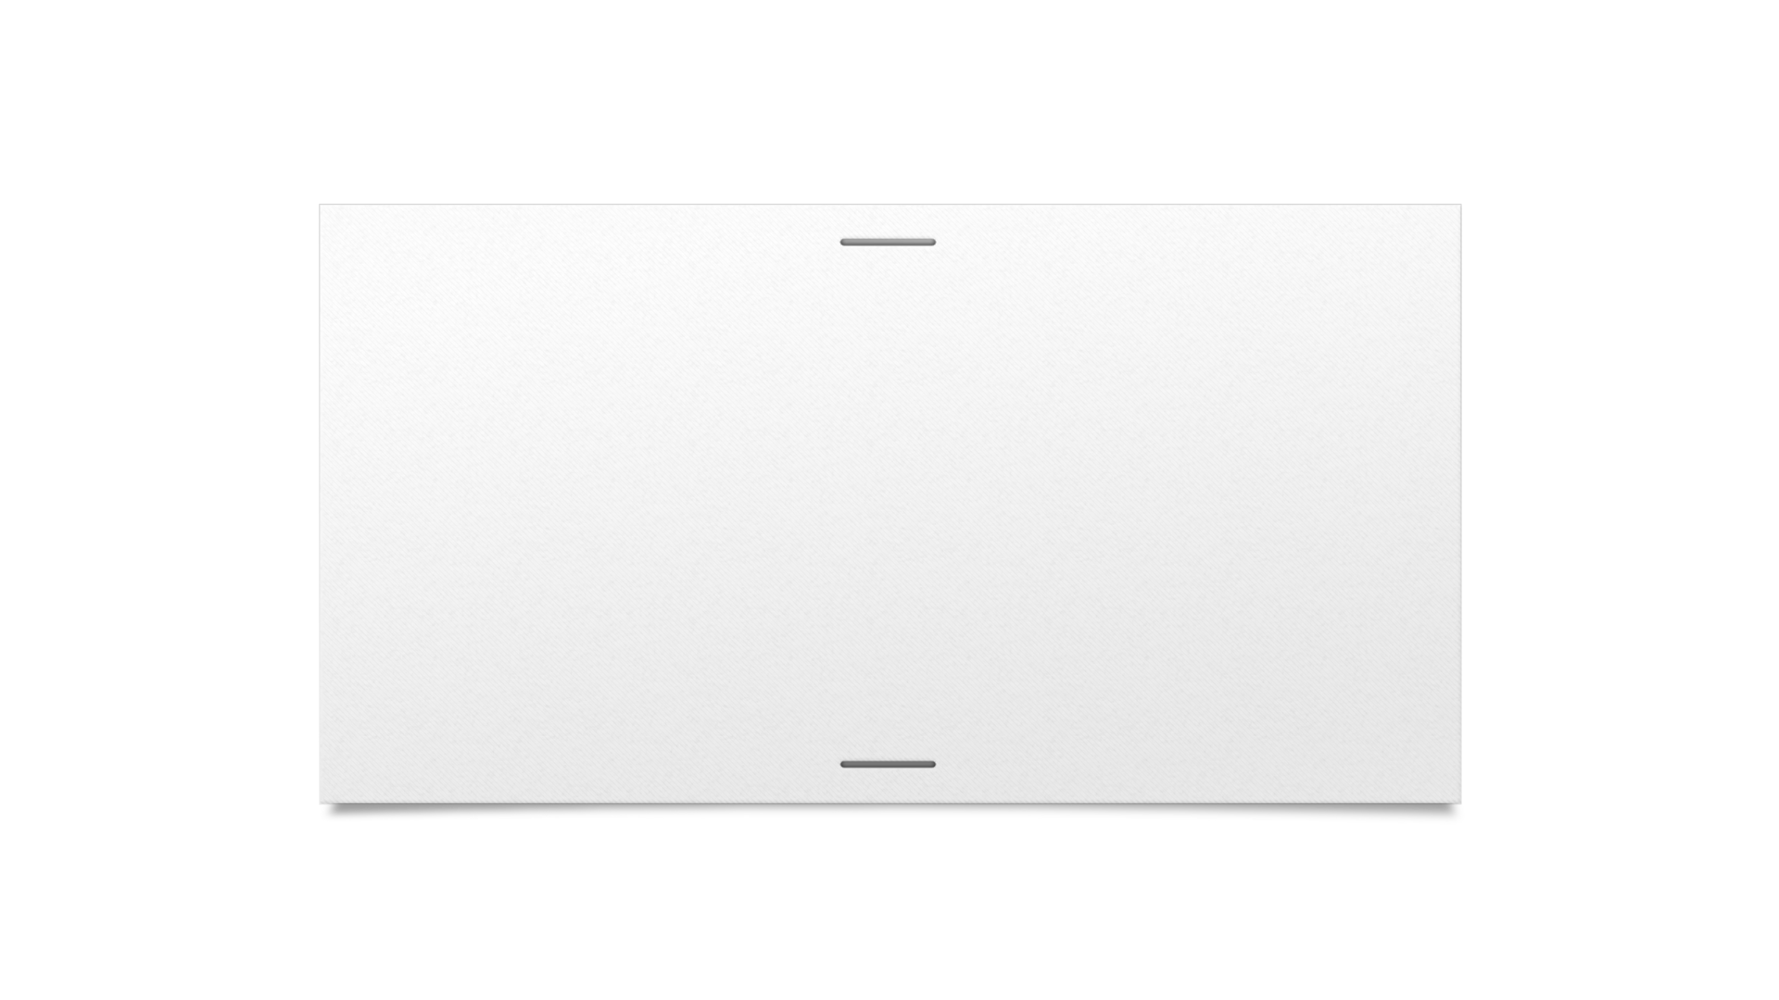


Dave
Game Project

Slide 2

Content:
Our team
Programs and languages we used
Resume
Advantages and disadvantages
How we did it?
Future plans

Slide 3
Our team
Plamen Kostov - Production manager
Ilian Yanev - Game director
Hristo Hristov - Graphics designer
Kristian Lalev - Game developer
Kiril Dimov - Game developer
Boris Simeonov - Site developer, Site director
Presyan Stefanov - Site developer
Stefan Ravninov - Site developer

Slide 4






Programs and languages we used

Slide 5
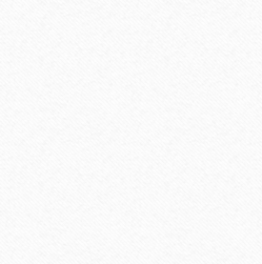
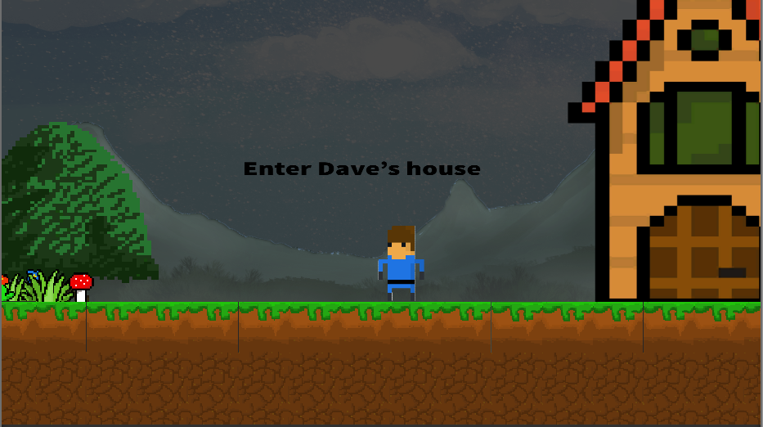
Resume
We created a 2D game for computer.

Slide 6
Advantages and disadvantages
Advantages:
Disadvantages:
We learnt new things and we collaborated with new people.
Our game doesn't have animations for moving.

Slide 7
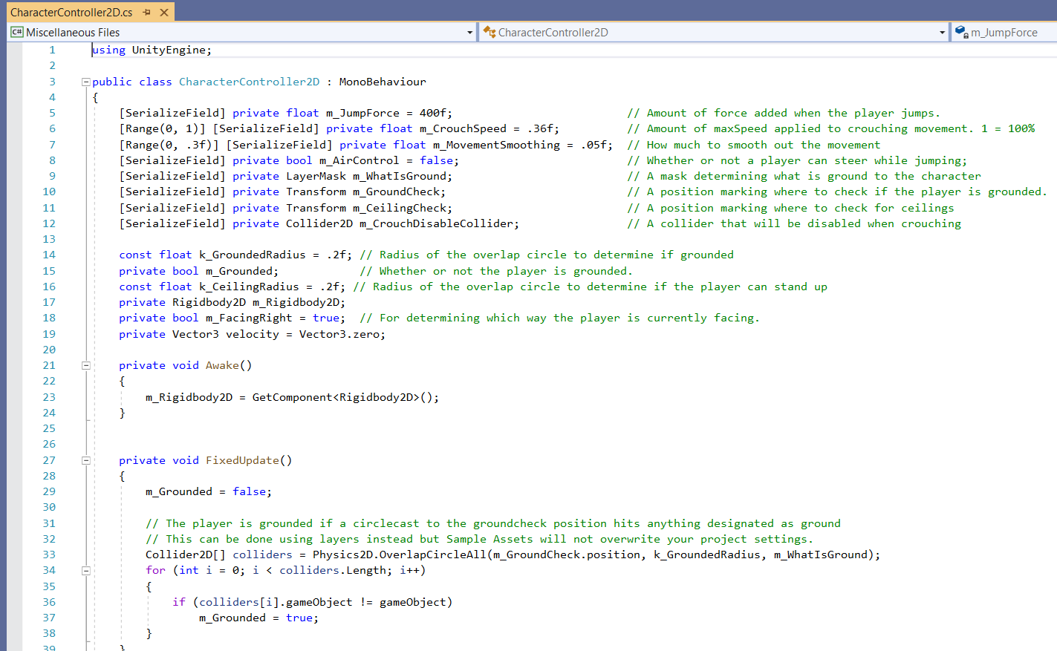
How we did it?
We used Unity to develop our app.

Slide 8
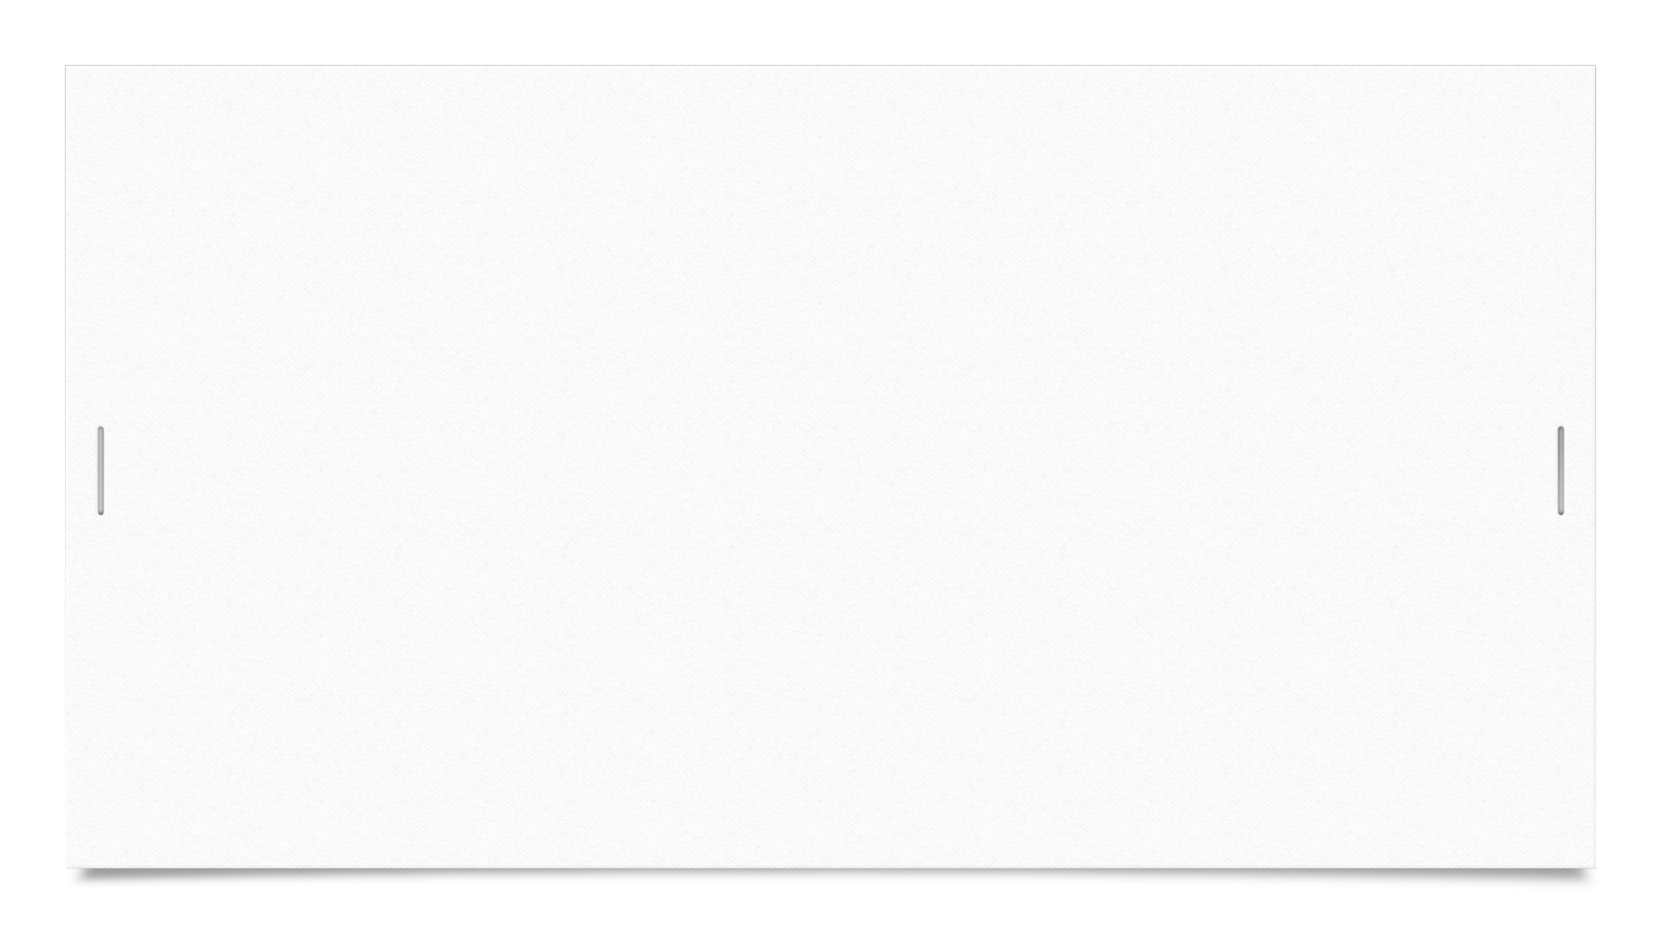


Future plans

Slide 9
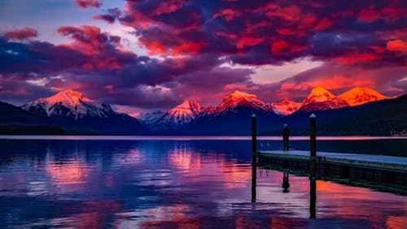
Thank you for the attention

